Slide 1
2-D AFFINE TRANSFORMATION
Unique and Least Squares Solutions

Slide 2
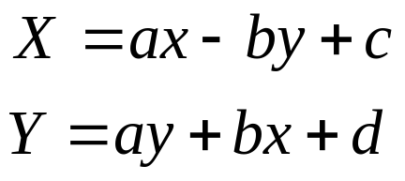
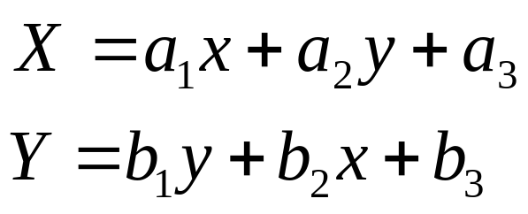
2-D Affine Transformation
2-D Conformal transformations include 2 parameters for change in origin (or translation), 1 parameter for change in orientation and 1 parameter for change in scale.
2-D affine transformations include 2 parameters for change in origin, 2 parameters for change in scale and 2 parameters for change in orientation.
The form of the 2-D conformal transformation equations was reduced to:
The form of the 2-D affine transformation equations is reduced to the form:

Slide 3
2-D Affine Transformation
The usual application of the 2-D affine transformation equations (as it was with the 2-D conformal equations) is when the parameters are first determined by utilizing known co-located points and then the equations with the known parameters included are applied to points known on one system to transform them to the other system.
Three co-located points are required from which 6 equations can be derived in order to determine the 6 parameters uniquely

Slide 4
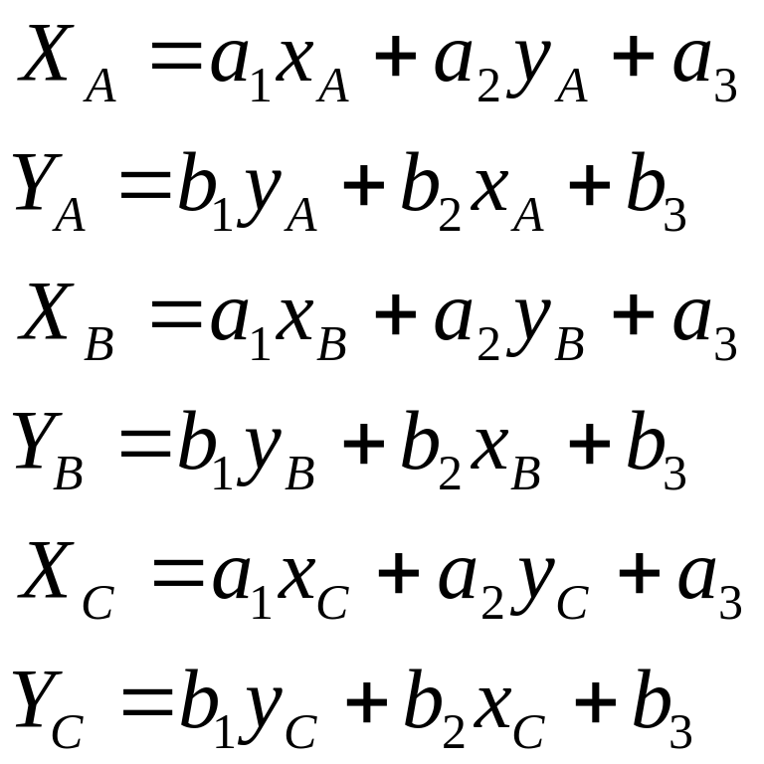
2-D Affine Transformation
For 3 co-located points, the equations are:

Slide 5
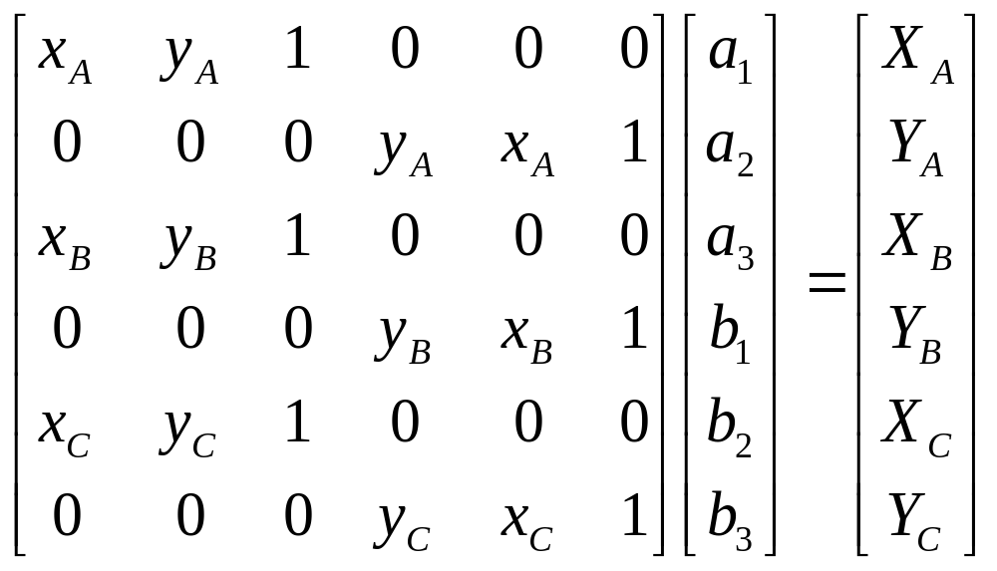
2-D Affine Transformation
These equations are of the linear equation form:
_{m}A^{n} _{n}X¹ = _{m}L¹
Where there are m equations and n unknowns and m = n so that:

Slide 6
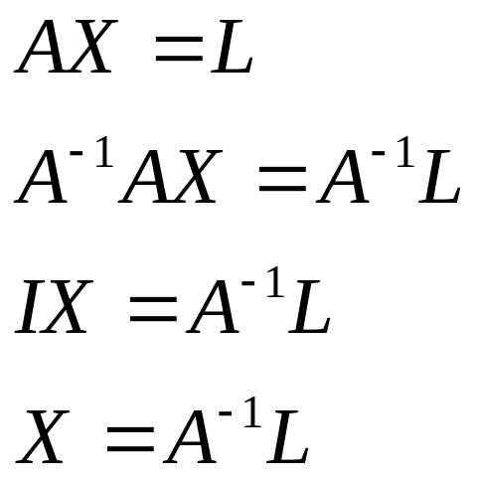

2-D Affine Transformation
The parameters can therefore be determined using matrix methods:
And other points may be transformed using matrix methods:

Slide 7
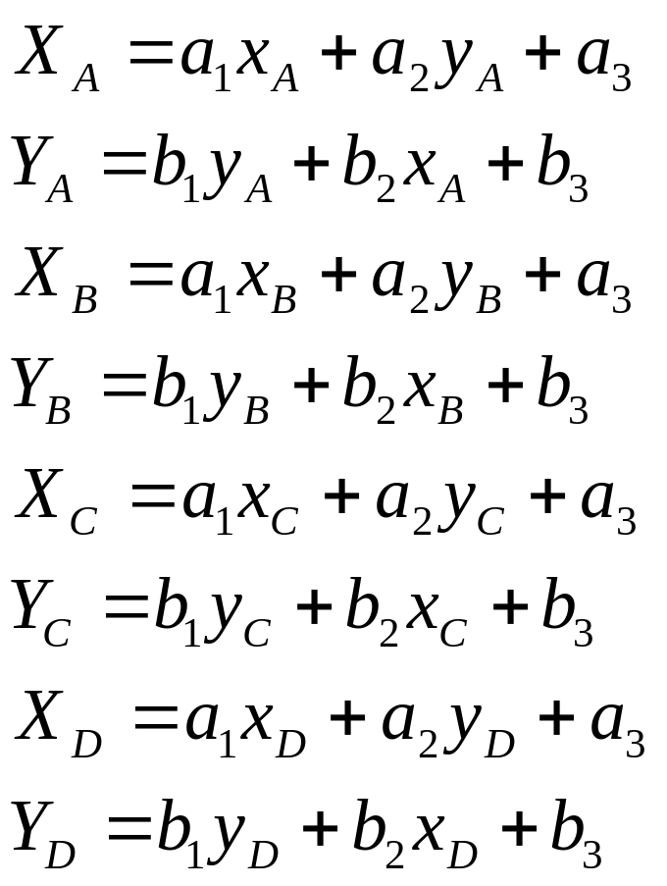
2-D Affine Transformation
When there is redundant information or more than 3 points are known on both systems, least squares may be used. For example if 4 points are known on both systems:
1) From the measurement equations:

Slide 8
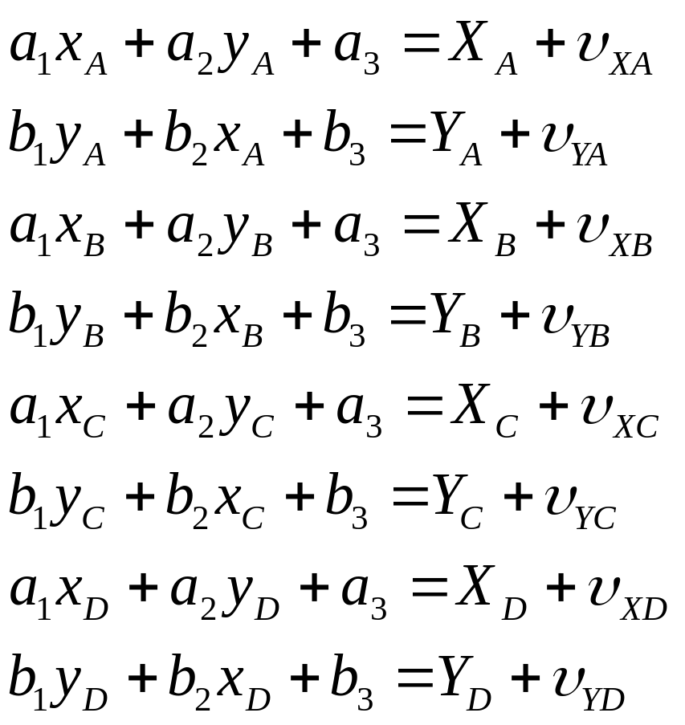
2-D Affine Transformation
2) Form the observation equations:

Slide 9
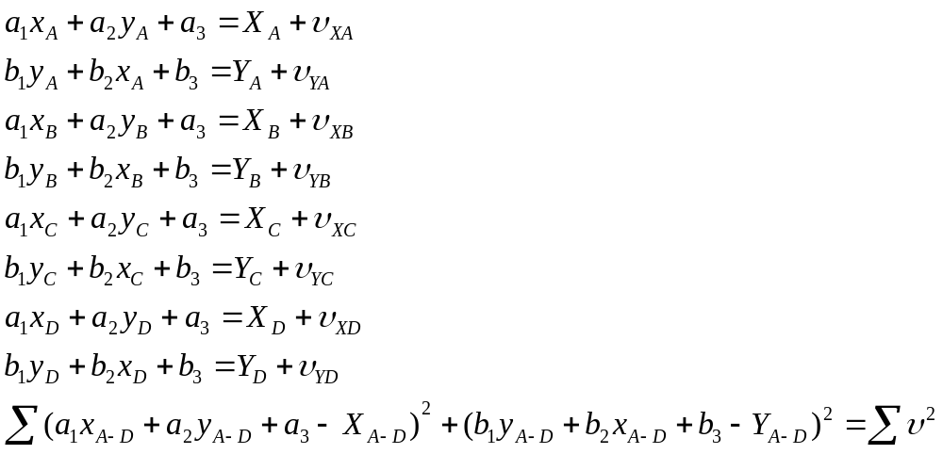
2-D Affine Transformation
3) Square the residuals and sum:

Slide 10
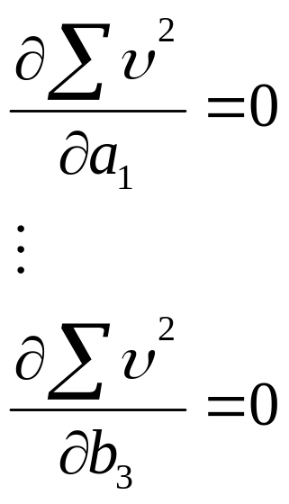
2-D Affine Transformation
4) Take partial differentials with respect to each unknown and equate to zero:
Normal equations
5) Solve simultaneously to obtain unique values for the unknowns

Slide 11
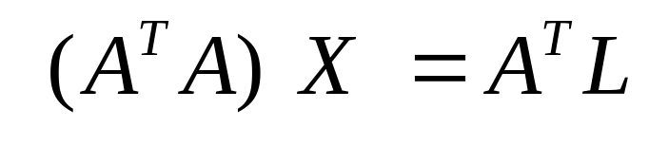
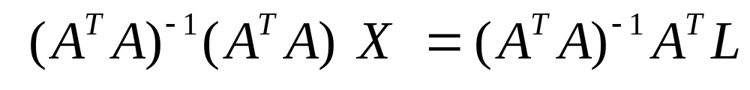
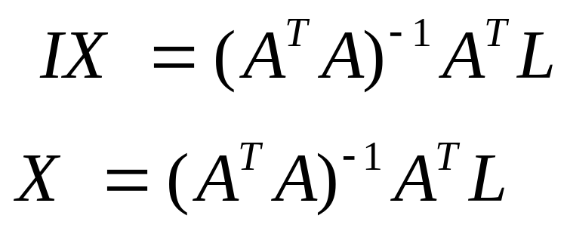
2-D Affine Transformation
It was shown previously that the normal equations can be formed directly using matrix methods:

Slide 12
2-D Affine Transformation
Example Wolf and Dewitt (2000)
Point | Comparator coord x mm | Comparator coord y mm | Calibrated coords X mm | Calibrated coords Y mm
Fiducial A | 228.170 | 129.730 | 112.995 | 0.034
Fiducial B | 2.100 | 129.520 | -113.006 | 0.005
Fiducial C | 115.005 | 242.625 | 0.003 | 112.993
Fiducial D | 115.274 | 16.574 | -0.012 | -113.000
1 | 206.674 | 123.794
2 | 198.365 | 132.856
3 | 91.505 | 18.956

Slide 13
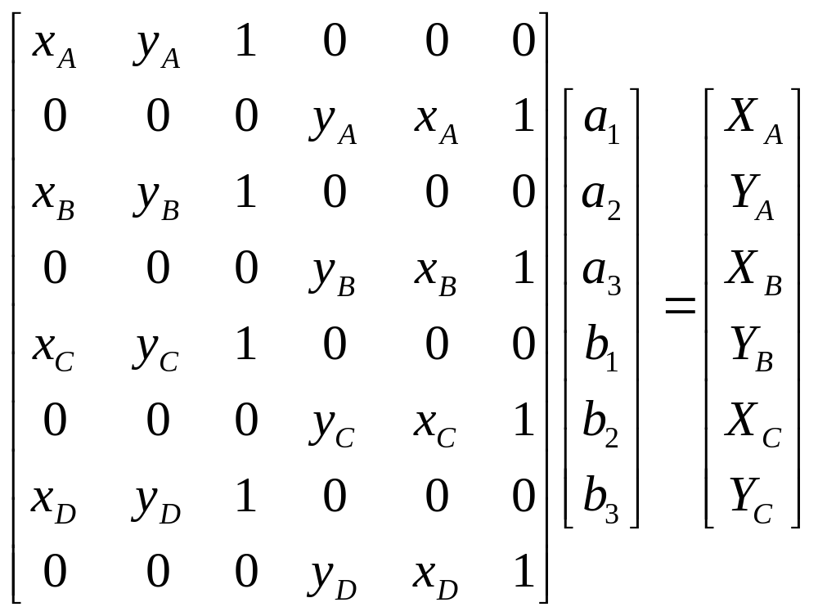
2-D Affine Transformation

Slide 14
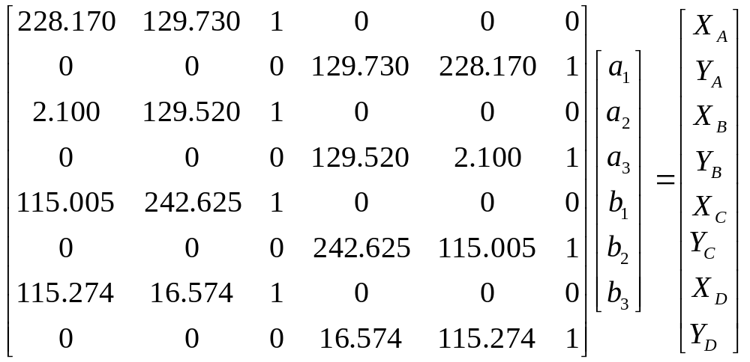
2-D Affine Transformation
AX = L

Slide 15
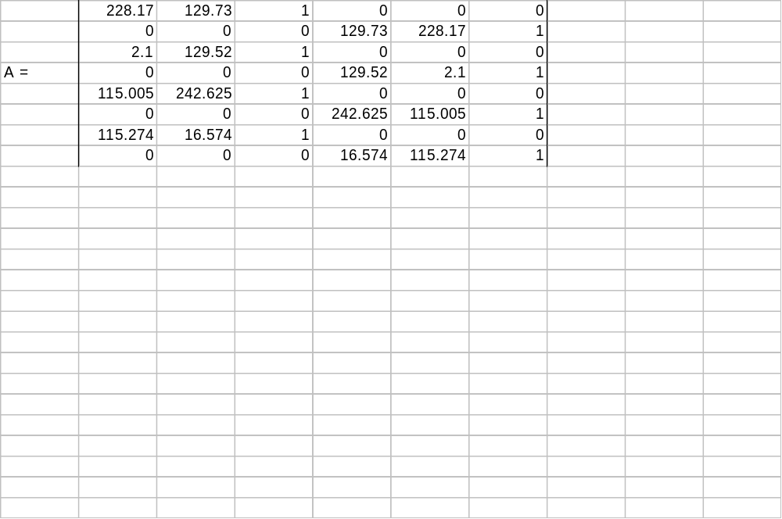
2-D Affine Transformation

